Slide 1
Chapter 17

Slide 2
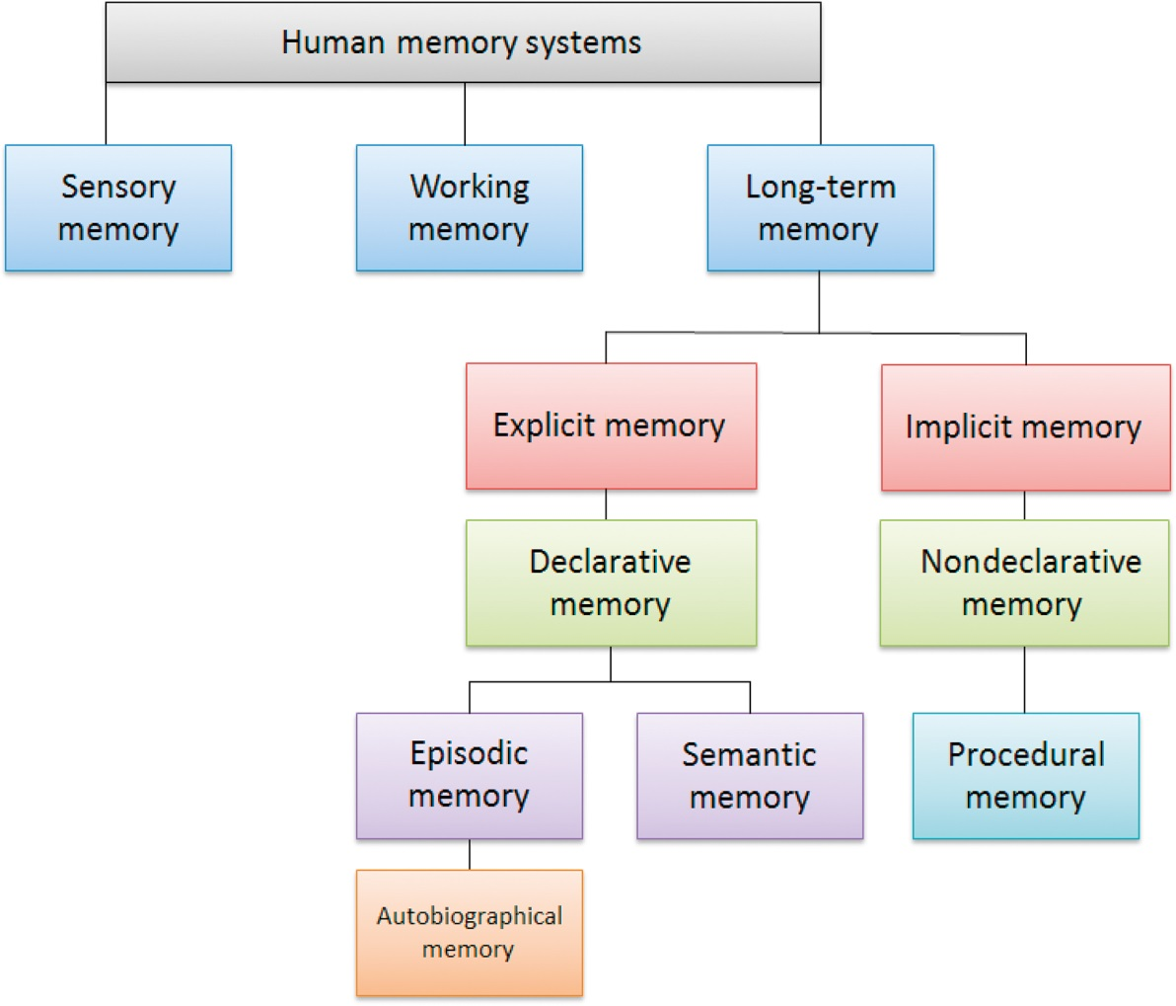
Figure 1 Hierarchical memory system subdivision.

Slide 3
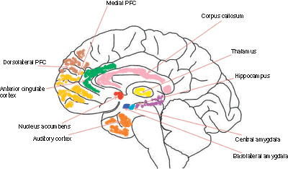
Figure 2 Brain structures involved in memory.

